Slide 1




Not All Claims are Created Equal: Choosing the Right Statistical Approach to Assess Hypotheses
arxiv.org/abs/1911.03850
Erfan Sadeqi-Azer (Indiana U → Google) Ashish Sabharwal (AI2) Dan Roth (UPenn).

Slide 2
The Cycle of Empirical Research

Slide 3
The Cycle of Empirical Research
Empirical Observations

Slide 4
The Cycle of Empirical Research
????
Research
Problem
Empirical Observations

Slide 5
The Cycle of Empirical Research
Hypothesis, or a General Premise
????
Research
Problem
Empirical Observations

Slide 6
The Cycle of Empirical Research
Hypothesis, or a General Premise
????
Research
Problem
Assessment/
Verification
Empirical Observations

Slide 7
The Cycle of Empirical Research
Hypothesis, or a General Premise
????
Research
Problem
Assessment/
Verification
Empirical Observations

Slide 8
Hypotheses

Slide 9
Hypotheses
A prediction about how the world will behave if our idea is correct
Worded as an if-then statement
A hypothesis is a testable prediction
A hypothesis is a falsifiable statement
Terminology:
A hypothesis is never “proved”
But it could be “supported” by the evidence

Slide 10
Hypotheses
A prediction about how the world will behave if our idea is correct
Worded as an if-then statement
A hypothesis is a testable prediction
A hypothesis is a falsifiable statement
Terminology:
A hypothesis is never “proved”
But it could be “supported” by the evidence

Slide 11
Hypotheses
A prediction about how the world will behave if our idea is correct
Worded as an if-then statement
A hypothesis is a testable prediction
A hypothesis is a falsifiable statement
Terminology:
A hypothesis is never “proved”
But it could be “supported” by the evidence

Slide 12
Hypotheses
A prediction about how the world will behave if our idea is correct
Worded as an if-then statement
A hypothesis is a testable prediction
A hypothesis is a falsifiable statement
Terminology:
A hypothesis is never “proved”
But it could be “supported” by the evidence

Slide 13
Hypotheses
A prediction about how the world will behave if our idea is correct
Worded as an if-then statement
A hypothesis is a testable prediction
A hypothesis is a falsifiable statement
Terminology:
A hypothesis is never “proved”
But it could be “supported” by the evidence

Slide 15
2020

Slide 16
2020
2020

Slide 17
2020
2020
<
?

Slide 18
Not a good statistical hypothesis
2020
2020
<
?

Slide 20
“I can always prepare a nice presentation, if I stay up the night before.”

Slide 21
A Typical AI Experiment
Hypothesis, or a General Premise
????
Research
Problem
Empirical Observations

Slide 22
A Typical AI Experiment
Hypothesis, or a General Premise
(Clark et al., 2018)
????
Research
Problem
System | Accuracy
Ⓐ | 72.4
Ⓑ | 68.9
Empirical Observations
|D|= 2376

Slide 23
A Typical AI Experiment
Hypothesis, or a General Premise
(Clark et al., 2018)
????
Research
Problem
System | Accuracy
Ⓐ | 72.4
Ⓑ | 68.9
Empirical Observations
|D|= 2376

Slide 24
A Typical AI Experiment
Can this apparent difference in performance be explained simply by random chance?
Do we have sufficient evidence to conclude that Ⓐ is in fact inherently stronger than Ⓑ on these datasets?
Hypothesis, or a General Premise
(Clark et al., 2018)
????
Research
Problem
System | Accuracy
Ⓐ | 72.4
Ⓑ | 68.9
Empirical Observations
|D|= 2376

Slide 25
A Typical AI Experiment
Can this apparent difference in performance be explained simply by random chance?
Do we have sufficient evidence to conclude that Ⓐ is in fact inherently stronger than Ⓑ on these datasets?
?
Hypothesis, or a General Premise
(Clark et al., 2018)
????
Research
Problem
System | Accuracy
Ⓐ | 72.4
Ⓑ | 68.9
Empirical Observations
|D|= 2376

Slide 26
A Typical AI Experiment: Example Hypotheses
System | Accuracy
Ⓐ | 72.4
Ⓑ | 68.9

Slide 27
A Typical AI Experiment: Example Hypotheses
System | Accuracy
Ⓐ | 72.4
Ⓑ | 68.9
C1*: Ⓐ and Ⓑ are inherently different, in the sense that if they were inherently identical, it would be highly unlikely to witness the observed 3.5% empirical gap.
C2*: Ⓐ and Ⓑ are inherently different, since with probability at least 95%, the inherent accuracy of Ⓐ exceeds that of Ⓑ by at least 𝛼%.

Slide 28
A Typical AI Experiment: Example Hypotheses
System | Accuracy
Ⓐ | 72.4
Ⓑ | 68.9
C1*: Ⓐ and Ⓑ are inherently different, in the sense that if they were inherently identical, it would be highly unlikely to witness the observed 3.5% empirical gap.
C2*: Ⓐ and Ⓑ are inherently different, since with probability at least 95%, the inherent accuracy of Ⓐ exceeds that of Ⓑ by at least 𝛼%.
* Under some statistical assumptions about sampling of the observations.

Slide 29
A Typical AI Experiment: Example Hypotheses
System | Accuracy
Ⓐ | 72.4
Ⓑ | 68.9
C1*: Ⓐ and Ⓑ are inherently different, in the sense that if they were inherently identical, it would be highly unlikely to witness the observed 3.5% empirical gap.
C2*: Ⓐ and Ⓑ are inherently different, since with probability at least 95%, the inherent accuracy of Ⓐ exceeds that of Ⓑ by at least 𝛼%.
* Under some statistical assumptions about sampling of the observations.

Slide 30
A Typical AI Experiment: Example Hypotheses
System | Accuracy
Ⓐ | 72.4
Ⓑ | 68.9
C1*: Ⓐ and Ⓑ are inherently different, in the sense that if they were inherently identical, it would be highly unlikely to witness the observed 3.5% empirical gap.
C2*: Ⓐ and Ⓑ are inherently different, since with probability at least 95%, the inherent accuracy of Ⓐ exceeds that of Ⓑ by at least 𝛼%.
* Under some statistical assumptions about sampling of the observations.

Slide 31
A Typical AI Experiment: Example Hypotheses
System | Accuracy
Ⓐ | 72.4
Ⓑ | 68.9
C1*: Ⓐ and Ⓑ are inherently different, in the sense that if they were inherently identical, it would be highly unlikely to witness the observed 3.5% empirical gap.
C2*: Ⓐ and Ⓑ are inherently different, since with probability at least 95%, the inherent accuracy of Ⓐ exceeds that of Ⓑ by at least 𝛼%.
* Under some statistical assumptions about sampling of the observations.

Slide 32
A Typical AI Experiment: Example Hypotheses
System | Accuracy
Ⓐ | 72.4
Ⓑ | 68.9
C1*: Ⓐ and Ⓑ are inherently different, in the sense that if they were inherently identical, it would be highly unlikely to witness the observed 3.5% empirical gap.
C2*: Ⓐ and Ⓑ are inherently different, since with probability at least 95%, the inherent accuracy of Ⓐ exceeds that of Ⓑ by at least 𝛼%.
* Under some statistical assumptions about sampling of the observations.

Slide 33
A Typical AI Experiment: Example Hypotheses
System | Accuracy
Ⓐ | 72.4
Ⓑ | 68.9
C1*: Ⓐ and Ⓑ are inherently different, in the sense that if they were inherently identical, it would be highly unlikely to witness the observed 3.5% empirical gap.
C2*: Ⓐ and Ⓑ are inherently different, since with probability at least 95%, the inherent accuracy of Ⓐ exceeds that of Ⓑ by at least 𝛼%.
* Under some statistical assumptions about sampling of the observations.

Slide 34
A Typical AI Experiment: Example Hypotheses
System | Accuracy
Ⓐ | 72.4
Ⓑ | 68.9
Spoiler Alert:
C1*: Ⓐ and Ⓑ are inherently different, in the sense that if they were inherently identical, it would be highly unlikely to witness the observed 3.5% empirical gap.
C2*: Ⓐ and Ⓑ are inherently different, since with probability at least 95%, the inherent accuracy of Ⓐ exceeds that of Ⓑ by at least 𝛼%.
* Under some statistical assumptions about sampling of the observations.

Slide 35
A Typical AI Experiment: Example Hypotheses
System | Accuracy
Ⓐ | 72.4
Ⓑ | 68.9
Spoiler Alert:
Almost everyone uses C1, even though it is harder to interpret.
C1*: Ⓐ and Ⓑ are inherently different, in the sense that if they were inherently identical, it would be highly unlikely to witness the observed 3.5% empirical gap.
C2*: Ⓐ and Ⓑ are inherently different, since with probability at least 95%, the inherent accuracy of Ⓐ exceeds that of Ⓑ by at least 𝛼%.
* Under some statistical assumptions about sampling of the observations.

Slide 36
A Typical AI Experiment: Example Hypotheses
System | Accuracy
Ⓐ | 72.4
Ⓑ | 68.9
Spoiler Alert:
Almost everyone uses C1, even though it is harder to interpret.
C1*: Ⓐ and Ⓑ are inherently different, in the sense that if they were inherently identical, it would be highly unlikely to witness the observed 3.5% empirical gap.
C2*: Ⓐ and Ⓑ are inherently different, since with probability at least 95%, the inherent accuracy of Ⓐ exceeds that of Ⓑ by at least 𝛼%.
* Under some statistical assumptions about sampling of the observations.
And many more . . .

Slide 37
Hypothesis-1
Research Question
Hypothesis-2
Hypothesis-3
…
Observation 1: There are many different hypotheses that could address a single research question.

Slide 39
Hypothesis vs Statistical Techniques
Research Question
Observation 2: Each hypothesis ought to be assessed with an appropriate statistical tool.

Slide 40
Hypothesis vs Statistical Techniques
Statistical Tool A
Hypothesis-1
Research Question
Statistical Tool B
Hypothesis-2
Statistical Tool C
Hypothesis-3
…
…
Observation 2: Each hypothesis ought to be assessed with an appropriate statistical tool.

Slide 41
Hypothesis vs Statistical Techniques
Statistical Tool A
Hypothesis-1
Research Question
Statistical Tool B
Hypothesis-2
Statistical Tool C
Hypothesis-3
…
…
Observation 2: Each hypothesis ought to be assessed with an appropriate statistical tool.
Corollary: Researchers should start with a hypothesis that best serves their goal, followed by an appropriate selection of a statistical approach.

Slide 42
Omission of hypotheses
Statistical Tool A
Hypothesis-1
Research Question
Statistical Tool B
Hypothesis-2
Statistical Tool C
Hypothesis-3
…
…

Slide 43
Omission of hypotheses
Observation 3: Somehow, we tend to forget about hypotheses
Statistical Tool A
Hypothesis-1
Research Question
Statistical Tool B
Hypothesis-2
Statistical Tool C
Hypothesis-3
…
…

Slide 44
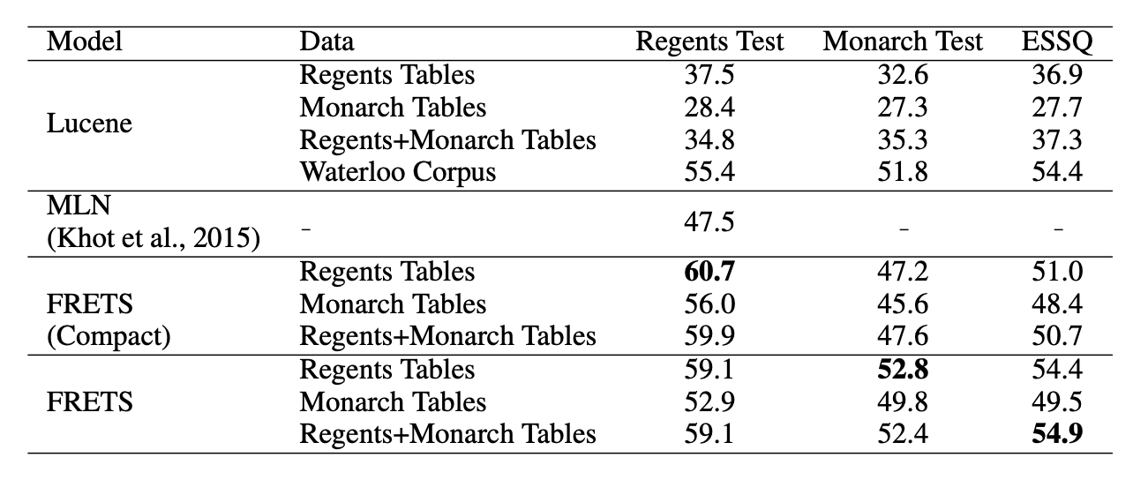
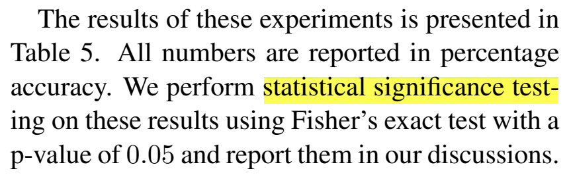
Omission of hypotheses
(EMNLP 2018)
Statistical Tool
Hypothesis
Research Question

Slide 45
Omission of hypotheses
(EMNLP 2018)
S1 >> S2
Statistical Tool
Hypothesis
Research Question

Slide 46
Omission of hypotheses
(EMNLP 2018)
S1 >> S2
Statistical Tool
Hypothesis
Research Question

Slide 47
Omission of hypotheses
(EMNLP 2018)
?
S1 >> S2
Statistical Tool
Hypothesis
Research Question

Slide 48
Omission of hypotheses
(EMNLP 2018)
?
S1 >> S2
Statistical Tool
Hypothesis
Research Question
Flawed practice: Many works use hypothesis assessment tests without knowing/stating their hypothesis.

Slide 49
Talk Summary & Statement
There are several serious malpractices:
Incomplete reporting of hypotheses and how they address research questions.
Inability to interpret statistical tools or their results.
Lack of awareness about various Bayesian hypothesis assessment tools.
Research works should be explicit about:
(a) Their choice of hypothesis and,
(b) How selected statistical tool addresses this hypothesis.

Slide 50
Statistical tools in this work . . .
Frequentist
Bayesian
Binary/Categorical Decisions
Null-Hypothesis Significance Test
Bayes Factor
Uncertainty Estimations
Confidence Interval
Posterior Intervals
(Kruschke and Liddell, 2018)

Slide 51
Statistical tools in this work . . .
Frequentist
Bayesian
Binary/Categorical Decisions
Null-Hypothesis Significance Test
Bayes Factor
Uncertainty Estimations
Confidence Interval
Posterior Intervals
(Kruschke and Liddell, 2018)

Slide 52
Frequentist
Bayesian
Binary/Categorical Decisions
Null-Hypothesis Significance Test
Bayes Factor
Uncertainty Estimations
Confidence Interval
Posterior Intervals

Slide 53
Notation

Slide 54
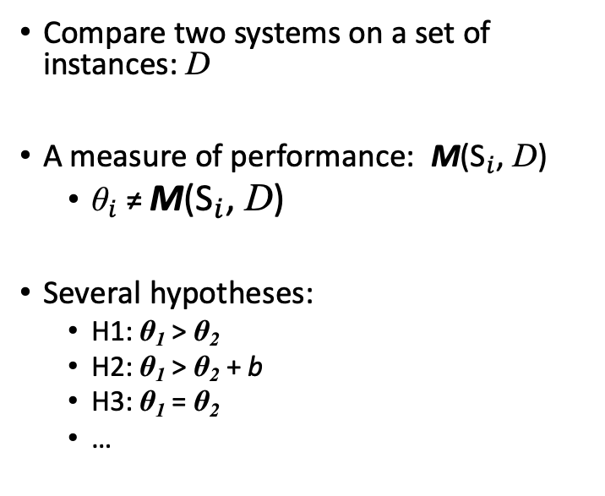
Notation
Compare two systems on a set of instances: D
A measure of performance: M(${\text{S}}_{i}$, D)
${\text{θ}}_{i}$≠ M(${\text{S}}_{i}$, D)
Several hypotheses:
H1: θ₁ > θ₂
H2: θ₁ > θ₂ + b
H3: θ₁ = θ₂
…

Slide 55
Notation
Input instances: D
Compare two systems on a set of instances: D
A measure of performance: M(${\text{S}}_{i}$, D)
${\text{θ}}_{i}$≠ M(${\text{S}}_{i}$, D)
Several hypotheses:
H1: θ₁ > θ₂
H2: θ₁ > θ₂ + b
H3: θ₁ = θ₂
…
S1
S2

Slide 56
Notation
Input instances: D
Compare two systems on a set of instances: D
A measure of performance: M(${\text{S}}_{i}$, D)
${\text{θ}}_{i}$≠ M(${\text{S}}_{i}$, D)
Several hypotheses:
H1: θ₁ > θ₂
H2: θ₁ > θ₂ + b
H3: θ₁ = θ₂
…
S1
S2

Slide 57
Notation
Input instances: D
Compare two systems on a set of instances: D
A measure of performance: M(${\text{S}}_{i}$, D)
${\text{θ}}_{i}$≠ M(${\text{S}}_{i}$, D)
Several hypotheses:
H1: θ₁ > θ₂
H2: θ₁ > θ₂ + b
H3: θ₁ = θ₂
…
S1
S2
Metric M

Slide 58
Notation
Input instances: D
Compare two systems on a set of instances: D
A measure of performance: M(${\text{S}}_{i}$, D)
${\text{θ}}_{i}$≠ M(${\text{S}}_{i}$, D)
Several hypotheses:
H1: θ₁ > θ₂
H2: θ₁ > θ₂ + b
H3: θ₁ = θ₂
…
S1
S2
Metric M
Observations

Slide 59
Notation
Input instances: D
Claims about the inherent properties θ₁,θ₂ of the two systems.
Compare two systems on a set of instances: D
A measure of performance: M(${\text{S}}_{i}$, D)
${\text{θ}}_{i}$≠ M(${\text{S}}_{i}$, D)
Several hypotheses:
H1: θ₁ > θ₂
H2: θ₁ > θ₂ + b
H3: θ₁ = θ₂
…
S1
S2
Metric M
Observations

Slide 60
Notation
Input instances: D
Claims about the inherent properties θ₁,θ₂ of the two systems.
Compare two systems on a set of instances: D
A measure of performance: M(${\text{S}}_{i}$, D)
${\text{θ}}_{i}$≠ M(${\text{S}}_{i}$, D)
Several hypotheses:
H1: θ₁ > θ₂
H2: θ₁ > θ₂ + b
H3: θ₁ = θ₂
…
S1
S2
Metric M
Observations

Slide 61
Notation
Input instances: D
Claims about the inherent properties θ₁,θ₂ of the two systems.
Compare two systems on a set of instances: D
A measure of performance: M(${\text{S}}_{i}$, D)
${\text{θ}}_{i}$≠ M(${\text{S}}_{i}$, D)
Several hypotheses:
H1: θ₁ > θ₂
H2: θ₁ > θ₂ + b
H3: θ₁ = θ₂
…
S1
S2
Metric M
Hypotheses
Observations

Slide 62
Notation
Input instances: D
Claims about the inherent properties θ₁,θ₂ of the two systems.
Compare two systems on a set of instances: D
A measure of performance: M(${\text{S}}_{i}$, D)
${\text{θ}}_{i}$≠ M(${\text{S}}_{i}$, D)
Several hypotheses:
H1: θ₁ > θ₂
H2: θ₁ > θ₂ + b
H3: θ₁ = θ₂
…
S1
S2
Metric M
Hypotheses
Observations

Slide 63
Notation
Input instances: D
Claims about the inherent properties θ₁,θ₂ of the two systems.
Compare two systems on a set of instances: D
A measure of performance: M(${\text{S}}_{i}$, D)
${\text{θ}}_{i}$≠ M(${\text{S}}_{i}$, D)
Several hypotheses:
H1: θ₁ > θ₂
H2: θ₁ > θ₂ + b
H3: θ₁ = θ₂
…
S1
S2
Metric M
Hypotheses
Observations

Slide 64
Notation
Input instances: D
Claims about the inherent properties θ₁,θ₂ of the two systems.
Compare two systems on a set of instances: D
A measure of performance: M(${\text{S}}_{i}$, D)
${\text{θ}}_{i}$≠ M(${\text{S}}_{i}$, D)
Several hypotheses:
H1: θ₁ > θ₂
H2: θ₁ > θ₂ + b
H3: θ₁ = θ₂
…
S1
S2
Metric M
Hypotheses
Observations

Slide 65
Notation
Input instances: D
Claims about the inherent properties θ₁,θ₂ of the two systems.
Compare two systems on a set of instances: D
A measure of performance: M(${\text{S}}_{i}$, D)
${\text{θ}}_{i}$≠ M(${\text{S}}_{i}$, D)
Several hypotheses:
H1: θ₁ > θ₂
H2: θ₁ > θ₂ + b
H3: θ₁ = θ₂
…
S1
S2
Metric M
Hypotheses
Observations

Slide 66
Notation
Input instances: D
Claims about the inherent properties θ₁,θ₂ of the two systems.
Compare two systems on a set of instances: D
A measure of performance: M(${\text{S}}_{i}$, D)
${\text{θ}}_{i}$≠ M(${\text{S}}_{i}$, D)
Several hypotheses:
H1: θ₁ > θ₂
H2: θ₁ > θ₂ + b
H3: θ₁ = θ₂
…
S1
S2
Metric M
Hypotheses
Observations

Slide 67
Notation
Input instances: D
Claims about the inherent properties θ₁,θ₂ of the two systems.
Compare two systems on a set of instances: D
A measure of performance: M(${\text{S}}_{i}$, D)
${\text{θ}}_{i}$≠ M(${\text{S}}_{i}$, D)
Several hypotheses:
H1: θ₁ > θ₂
H2: θ₁ > θ₂ + b
H3: θ₁ = θ₂
…
S1
S2
Metric M
Hypotheses
Hypothesis Assessment
Observations

Slide 68
Notation
Input instances: D
Claims about the inherent properties θ₁,θ₂ of the two systems.
Compare two systems on a set of instances: D
A measure of performance: M(${\text{S}}_{i}$, D)
${\text{θ}}_{i}$≠ M(${\text{S}}_{i}$, D)
Several hypotheses:
H1: θ₁ > θ₂
H2: θ₁ > θ₂ + b
H3: θ₁ = θ₂
…
S1
S2
Metric M
Hypotheses
Hypothesis Assessment
Observations
Conclusions validating
(or not) the hypotheses.

Slide 69
Null-Hypothesis Significance Testing
(Søgaard et al., 2014; Koehn, 2004; Dror and Reichart, 2018)

Slide 70
Null-Hypothesis Significance Testing
The goal is to decide whether a particular hypothesis can be rejected.
Make a hypothesis (that you want it to be rejected): null-hypothesis.
Assume that null-hypothesis is correct.
Calculate the probability of getting an outcome as “extreme” or more than the observed outcome.
This probability is called a “p-value.”
(Søgaard et al., 2014; Koehn, 2004; Dror and Reichart, 2018)

Slide 71
Null-Hypothesis Significance Testing
The goal is to decide whether a particular hypothesis can be rejected.
Make a hypothesis (that you want it to be rejected): null-hypothesis.
Assume that null-hypothesis is correct.
Calculate the probability of getting an outcome as “extreme” or more than the observed outcome.
This probability is called a “p-value.”
(Søgaard et al., 2014; Koehn, 2004; Dror and Reichart, 2018)

Slide 72
Null-Hypothesis Significance Testing
The goal is to decide whether a particular hypothesis can be rejected.
Make a hypothesis (that you want it to be rejected): null-hypothesis.
Assume that null-hypothesis is correct.
Calculate the probability of getting an outcome as “extreme” or more than the observed outcome.
This probability is called a “p-value.”
H₀: θ₁ =θ₂
(Søgaard et al., 2014; Koehn, 2004; Dror and Reichart, 2018)

Slide 73
Null-Hypothesis Significance Testing
The goal is to decide whether a particular hypothesis can be rejected.
Make a hypothesis (that you want it to be rejected): null-hypothesis.
Assume that null-hypothesis is correct.
Calculate the probability of getting an outcome as “extreme” or more than the observed outcome.
This probability is called a “p-value.”
H₀: θ₁ =θ₂
(Søgaard et al., 2014; Koehn, 2004; Dror and Reichart, 2018)

Slide 74
Null-Hypothesis Significance Testing
The goal is to decide whether a particular hypothesis can be rejected.
Make a hypothesis (that you want it to be rejected): null-hypothesis.
Assume that null-hypothesis is correct.
Calculate the probability of getting an outcome as “extreme” or more than the observed outcome.
This probability is called a “p-value.”
H₀: θ₁ =θ₂
e.g., a bigger accuracy improvement.
(Søgaard et al., 2014; Koehn, 2004; Dror and Reichart, 2018)

Slide 75
Null-Hypothesis Significance Testing
The goal is to decide whether a particular hypothesis can be rejected.
Make a hypothesis (that you want it to be rejected): null-hypothesis.
Assume that null-hypothesis is correct.
Calculate the probability of getting an outcome as “extreme” or more than the observed outcome.
This probability is called a “p-value.”
H₀: θ₁ =θ₂
e.g., a bigger accuracy improvement.
(Søgaard et al., 2014; Koehn, 2004; Dror and Reichart, 2018)

Slide 76
P-value, Visualized

Slide 77
P-value, Visualized
Null-hypothesis: a hypothesis you want to reject & assume that it is correct.
P-value: the probability of getting an outcome as “extreme” or more than the observed outcome.
A small p-value is used as a stronger evidence towards rejecting the null-hypothesis.

Slide 78
P-value, Visualized
Null-hypothesis: a hypothesis you want to reject & assume that it is correct.
P-value: the probability of getting an outcome as “extreme” or more than the observed outcome.
A small p-value is used as a stronger evidence towards rejecting the null-hypothesis.

Slide 79
P-value, Visualized
Null-hypothesis: a hypothesis you want to reject & assume that it is correct.
P-value: the probability of getting an outcome as “extreme” or more than the observed outcome.
A small p-value is used as a stronger evidence towards rejecting the null-hypothesis.

Slide 80

P-value, Visualized
Null-hypothesis: a hypothesis you want to reject & assume that it is correct.
P-value: the probability of getting an outcome as “extreme” or more than the observed outcome.
A small p-value is used as a stronger evidence towards rejecting the null-hypothesis.
all possible outcomes

Slide 81
P-value, Visualized
Null-hypothesis: a hypothesis you want to reject & assume that it is correct.
P-value: the probability of getting an outcome as “extreme” or more than the observed outcome.
A small p-value is used as a stronger evidence towards rejecting the null-hypothesis.
all possible outcomes

Slide 82
P-value, Visualized
Null-hypothesis: a hypothesis you want to reject & assume that it is correct.
P-value: the probability of getting an outcome as “extreme” or more than the observed outcome.
A small p-value is used as a stronger evidence towards rejecting the null-hypothesis.
the actual outcome
all possible outcomes

Slide 83
P-value, Visualized
Null-hypothesis: a hypothesis you want to reject & assume that it is correct.
P-value: the probability of getting an outcome as “extreme” or more than the observed outcome.
A small p-value is used as a stronger evidence towards rejecting the null-hypothesis.
the actual outcome
all possible outcomes

Slide 84
P-value, Visualized
Null-hypothesis: a hypothesis you want to reject & assume that it is correct.
P-value: the probability of getting an outcome as “extreme” or more than the observed outcome.
A small p-value is used as a stronger evidence towards rejecting the null-hypothesis.
“extremer” outcomes
the actual outcome
all possible outcomes

Slide 85

P-value, Visualized
Null-hypothesis: a hypothesis you want to reject & assume that it is correct.
P-value: the probability of getting an outcome as “extreme” or more than the observed outcome.
A small p-value is used as a stronger evidence towards rejecting the null-hypothesis.
“extremer” outcomes
the actual outcome
all possible outcomes

Slide 86
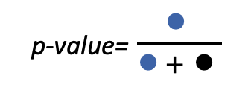
P-value, Visualized
Null-hypothesis: a hypothesis you want to reject & assume that it is correct.
P-value: the probability of getting an outcome as “extreme” or more than the observed outcome.
A small p-value is used as a stronger evidence towards rejecting the null-hypothesis.
“extremer” outcomes
the actual outcome
p-value=$\frac{\text{●}}{\text{●}+ \text{●}}$
all possible outcomes

Slide 87
P-value, Visualized
Null-hypothesis: a hypothesis you want to reject & assume that it is correct.
P-value: the probability of getting an outcome as “extreme” or more than the observed outcome.
A small p-value is used as a stronger evidence towards rejecting the null-hypothesis.
“extremer” outcomes
the actual outcome
p-value=$\frac{\text{●}}{\text{●}+ \text{●}}$
all possible outcomes

Slide 88
P-value, Visualized
Null-hypothesis: a hypothesis you want to reject & assume that it is correct.
P-value: the probability of getting an outcome as “extreme” or more than the observed outcome.
A small p-value is used as a stronger evidence towards rejecting the null-hypothesis.
“extremer” outcomes
the actual outcome
p-value=$\frac{\text{●}}{\text{●}+ \text{●}}$
all possible outcomes

Slide 89
P-value, Visualized
Null-hypothesis: a hypothesis you want to reject & assume that it is correct.
P-value: the probability of getting an outcome as “extreme” or more than the observed outcome.
A small p-value is used as a stronger evidence towards rejecting the null-hypothesis.
“extremer” outcomes
bigger
p-value
the actual outcome
p-value=$\frac{\text{●}}{\text{●}+ \text{●}}$
all possible outcomes

Slide 90
P-value, Visualized
Null-hypothesis: a hypothesis you want to reject & assume that it is correct.
P-value: the probability of getting an outcome as “extreme” or more than the observed outcome.
A small p-value is used as a stronger evidence towards rejecting the null-hypothesis.
“extremer” outcomes
bigger
p-value
the actual outcome
😭
p-value=$\frac{\text{●}}{\text{●}+ \text{●}}$
all possible outcomes

Slide 91
Null-Hypothesis Significance Testing: Example
System | Accuracy
Ⓐ | 72.4%
Ⓑ | 68.9%

Slide 92
Null-Hypothesis Significance Testing: Example
Hypothesis H1: θ₁ > θ₂
System | Accuracy
Ⓐ | 72.4%
Ⓑ | 68.9%

Slide 93
Null-Hypothesis Significance Testing: Example
Hypothesis H1: θ₁ > θ₂
Null-Hypothesis H0: θ₁ = θ₂
System | Accuracy
Ⓐ | 72.4%
Ⓑ | 68.9%

Slide 94
Null-Hypothesis Significance Testing: Example
Hypothesis H1: θ₁ > θ₂
Null-Hypothesis H0: θ₁ = θ₂
System | Accuracy
Ⓐ | 72.4%
Ⓑ | 68.9%

Slide 95
Null-Hypothesis Significance Testing: Example
Hypothesis H1: θ₁ > θ₂
Null-Hypothesis H0: θ₁ = θ₂
System | Accuracy
Ⓐ | 72.4%
Ⓑ | 68.9%

Slide 96
Null-Hypothesis Significance Testing: Example
Hypothesis H1: θ₁ > θ₂
Null-Hypothesis H0: θ₁ = θ₂
System | Accuracy
Ⓐ | 72.4%
Ⓑ | 68.9%

Slide 97
Null-Hypothesis Significance Testing: Example
Hypothesis H1: θ₁ > θ₂
Null-Hypothesis H0: θ₁ = θ₂
System | Accuracy
Ⓐ | 72.4%
Ⓑ | 68.9%

Slide 98
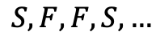
Null-Hypothesis Significance Testing: Example
Hypothesis H1: θ₁ > θ₂
Null-Hypothesis H0: θ₁ = θ₂
System | Accuracy
Ⓐ | 72.4%
Ⓑ | 68.9%
$$S, F,F,S,…$$

Slide 99
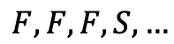
Null-Hypothesis Significance Testing: Example
Hypothesis H1: θ₁ > θ₂
Null-Hypothesis H0: θ₁ = θ₂
System | Accuracy
Ⓐ | 72.4%
Ⓑ | 68.9%
$$S, F,F,S,…$$
$$F, F,F,S,…$$

Slide 100
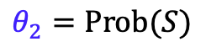
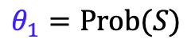
Null-Hypothesis Significance Testing: Example
Hypothesis H1: θ₁ > θ₂
Null-Hypothesis H0: θ₁ = θ₂
$$θ_{1}=Prob(S)$$
System | Accuracy
Ⓐ | 72.4%
Ⓑ | 68.9%
$$S, F,F,S,…$$
$$θ_{2}=Prob(S)$$
$$F, F,F,S,…$$

Slide 101
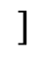
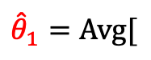
Null-Hypothesis Significance Testing: Example
Hypothesis H1: θ₁ > θ₂
Null-Hypothesis H0: θ₁ = θ₂
$$θ_{1}=Prob(S)$$
System | Accuracy
Ⓐ | 72.4%
Ⓑ | 68.9%
$${\hat{θ}}_{1}=Avg[$$
$$]$$
$$S, F,F,S,…$$
$$θ_{2}=Prob(S)$$
$$F, F,F,S,…$$

Slide 102
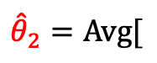

Null-Hypothesis Significance Testing: Example
Hypothesis H1: θ₁ > θ₂
Null-Hypothesis H0: θ₁ = θ₂
$$θ_{1}=Prob(S)$$
System | Accuracy
Ⓐ | 72.4%
Ⓑ | 68.9%
$${\hat{θ}}_{1}=Avg[$$
$$]$$
$$S, F,F,S,…$$
$$θ_{2}=Prob(S)$$
$${\hat{θ}}_{2}=Avg[$$
$$F, F,F,S,…$$
$$]$$

Slide 103
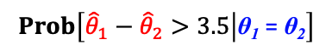
Null-Hypothesis Significance Testing: Example
Hypothesis H1: θ₁ > θ₂
Null-Hypothesis H0: θ₁ = θ₂
$$θ_{1}=Prob(S)$$
System | Accuracy
Ⓐ | 72.4%
Ⓑ | 68.9%
$${\hat{θ}}_{1}=Avg[$$
$$]$$
$$S, F,F,S,…$$
$$θ_{2}=Prob(S)$$
$${\hat{θ}}_{2}=Avg[$$
$$F, F,F,S,…$$
$$]$$
$$Prob\left[{\hat{θ}}_{1}−{\hat{θ}}_{2}>3.5 | \text{θ}\text{1} \text{=} \text{θ}\text{2}\right]$$

Slide 104
Null-Hypothesis Significance Testing: Example
Hypothesis H1: θ₁ > θ₂
Null-Hypothesis H0: θ₁ = θ₂
$$θ_{1}=Prob(S)$$
System | Accuracy
Ⓐ | 72.4%
Ⓑ | 68.9%
$${\hat{θ}}_{1}=Avg[$$
$$]$$
$$S, F,F,S,…$$
$$θ_{2}=Prob(S)$$
$${\hat{θ}}_{2}=Avg[$$
$$F, F,F,S,…$$
$$]$$
P-value=
$$Prob\left[{\hat{θ}}_{1}−{\hat{θ}}_{2}>3.5 | \text{θ}\text{1} \text{=} \text{θ}\text{2}\right]$$

Slide 105
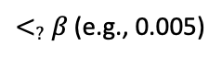
Null-Hypothesis Significance Testing: Example
Hypothesis H1: θ₁ > θ₂
Null-Hypothesis H0: θ₁ = θ₂
$$θ_{1}=Prob(S)$$
System | Accuracy
Ⓐ | 72.4%
Ⓑ | 68.9%
$${\hat{θ}}_{1}=Avg[$$
$$]$$
$$S, F,F,S,…$$
$$θ_{2}=Prob(S)$$
$${\hat{θ}}_{2}=Avg[$$
$$F, F,F,S,…$$
$$]$$
P-value=
$$Prob\left[{\hat{θ}}_{1}−{\hat{θ}}_{2}>3.5 | \text{θ}\text{1} \text{=} \text{θ}\text{2}\right]$$
$<_{?}$ $β$ (e.g., 0.005)

Slide 106
Null-Hypothesis Significance Testing: Example
Hypothesis H1: θ₁ > θ₂
Null-Hypothesis H0: θ₁ = θ₂
$$θ_{1}=Prob(S)$$
System | Accuracy
Ⓐ | 72.4%
Ⓑ | 68.9%
$${\hat{θ}}_{1}=Avg[$$
$$]$$
$$S, F,F,S,…$$
$$θ_{2}=Prob(S)$$
$${\hat{θ}}_{2}=Avg[$$
$$F, F,F,S,…$$
$$]$$
One-sided z-test
P-value=
$$Prob\left[{\hat{θ}}_{1}−{\hat{θ}}_{2}>3.5 | \text{θ}\text{1} \text{=} \text{θ}\text{2}\right]$$
$<_{?}$ $β$ (e.g., 0.005)

Slide 107
Interpreting p-values

Slide 108
Interpreting p-values
Pretty complex notion!

Slide 109
Interpreting p-values
Pretty complex notion!
“The probability of obtaining test results at least as extreme as the results actually observed during the test, assuming that the null-hypothesis is correct.” --your favorite statistics textbook

Slide 110
Interpreting p-value
If p < 0.05, the null-hypothesis has only a 5% chance of being true
(Demsar, 2008; Goodman, 2008)

Slide 111
Interpreting p-value
If p < 0.05, the null-hypothesis has only a 5% chance of being true
(Demsar, 2008; Goodman, 2008)

Slide 112
Interpreting p-value
If p < 0.05, the null-hypothesis has only a 5% chance of being true
Remember that p-value is defined with the assumption that null-hypothesis is correct.
(Demsar, 2008; Goodman, 2008)

Slide 113
Interpreting p-value
If p > 0.05, there is no difference between the two systems
(Demsar, 2008; Goodman, 2008)

Slide 114
Interpreting p-value
If p > 0.05, there is no difference between the two systems
(Demsar, 2008; Goodman, 2008)

Slide 115
Interpreting p-value
If p > 0.05, there is no difference between the two systems
Having a large p-value only means that the null-hypothesis is consistent with the observations,
… but it does not tell anything about the likeliness of the null-hypothesis.
(Demsar, 2008; Goodman, 2008)

Slide 116
Interpreting p-value
If p > 0.05, there is no difference between the two systems
Having a large p-value only means that the null-hypothesis is consistent with the observations,
… but it does not tell anything about the likeliness of the null-hypothesis.
(Demsar, 2008; Goodman, 2008)

Slide 117
Interpreting p-value
A statistically significant result (p < 0.05) indicates a large/notable difference between two systems.
(Demsar, 2008; Goodman, 2008)

Slide 118
Interpreting p-value
A statistically significant result (p < 0.05) indicates a large/notable difference between two systems.
(Demsar, 2008; Goodman, 2008)

Slide 119
Interpreting p-value
A statistically significant result (p < 0.05) indicates a large/notable difference between two systems.
P-value only indicates strict superiority and provides no information about the margin of the effect.
(Demsar, 2008; Goodman, 2008)

Slide 120
Remember this?

Slide 121
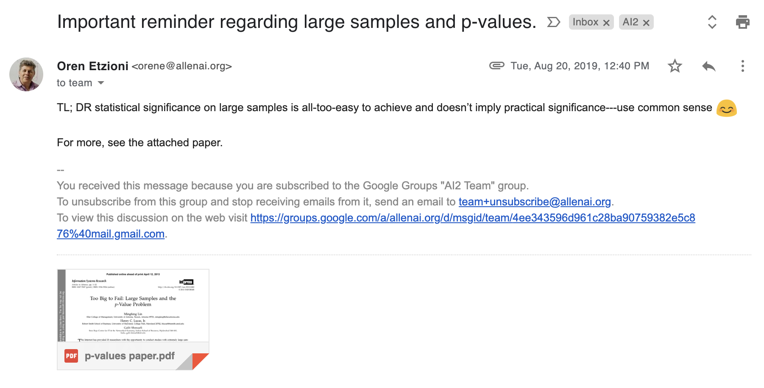
Remember this?

Slide 122
Remember this?

Slide 123
Remember this?

Slide 124
Remember this?
Or just keep listening to Daniel’s presentation!

Slide 125
Intermediate Summary
Frequentist
Bayesian
Binary Decision
Null-Hypothesis Significance Test
Bayes Factor
Uncertainty Estimations
Confidence Interval
Posterior Intervals

Slide 126
Intermediate Summary
P-values do not provide probability estimates on two classifiers being different (or equal).
Frequentist
Bayesian
Binary Decision
Null-Hypothesis Significance Test
Bayes Factor
Uncertainty Estimations
Confidence Interval
Posterior Intervals

Slide 127
Intermediate Summary
P-values do not provide probability estimates on two classifiers being different (or equal).
Statistical significance is different than practical significance.
Point-wise null hypotheses could be misused: for big enough data points it is possible to make statistically significant claims.
Frequentist
Bayesian
Binary Decision
Null-Hypothesis Significance Test
Bayes Factor
Uncertainty Estimations
Confidence Interval
Posterior Intervals

Slide 128
Intermediate Summary
P-values do not provide probability estimates on two classifiers being different (or equal).
Statistical significance is different than practical significance.
Point-wise null hypotheses could be misused: for big enough data points it is possible to make statistically significant claims.
Frequentist
Bayesian
Binary Decision
Null-Hypothesis Significance Test
Bayes Factor
Uncertainty Estimations
Confidence Interval
Posterior Intervals

Slide 129
Frequentist
Bayesian
Binary/Categorical Decisions
Null-Hypothesis Significance Test
Bayes Factor
Uncertainty Estimations
Confidence Interval
Posterior Intervals

Slide 130
Frequentist
Bayesian
Binary/Categorical Decisions
Null-Hypothesis Significance Test
Bayes Factor
Uncertainty Estimations
Confidence Interval
Posterior Intervals

Slide 131
Posterior Intervals
Based on Bayesian inference framework.
(Thomas Bayes 1702-1761)

Slide 132
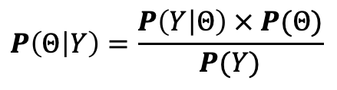
Posterior Intervals
$$P\left(Θ | Y\right)=\frac{P\left(Y | Θ\right) × P(Θ)}{P(Y)}$$

Slide 133
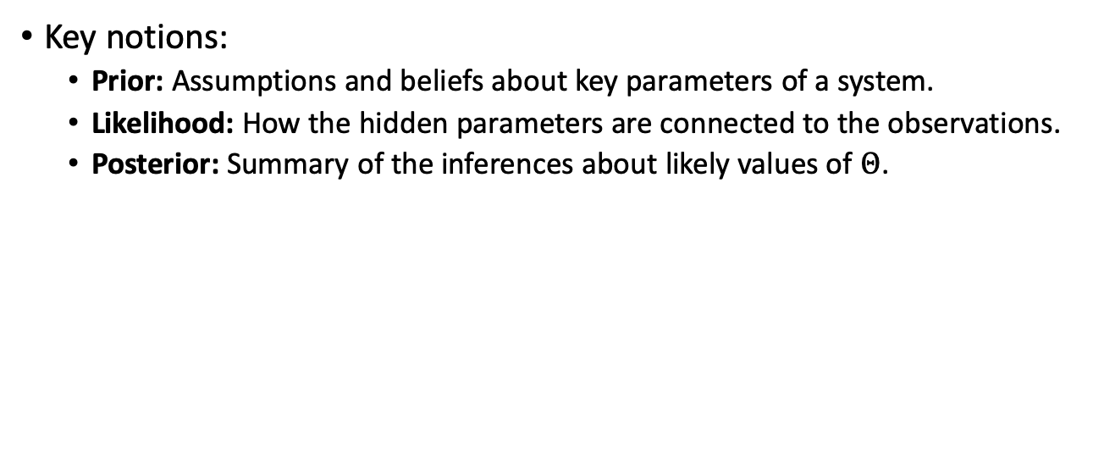
Posterior Intervals
Key notions:
Prior: Assumptions and beliefs about key parameters of a system.
Likelihood: How the hidden parameters are connected to the observations.
Posterior: Summary of the inferences about likely values of $Θ$.
$$P\left(Θ | Y\right)=\frac{P\left(Y | Θ\right) × P(Θ)}{P(Y)}$$

Slide 134
Posterior Intervals
Key notions:
Prior: Assumptions and beliefs about key parameters of a system.
Likelihood: How the hidden parameters are connected to the observations.
Posterior: Summary of the inferences about likely values of $Θ$.
$$P\left(Θ | Y\right)=\frac{P\left(Y | Θ\right) × P(Θ)}{P(Y)}$$

Slide 135
Posterior Intervals
Key notions:
Prior: Assumptions and beliefs about key parameters of a system.
Likelihood: How the hidden parameters are connected to the observations.
Posterior: Summary of the inferences about likely values of $Θ$.
$$P\left(Θ | Y\right)=\frac{P\left(Y | Θ\right) × P(Θ)}{P(Y)}$$

Slide 136
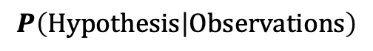
Posterior Intervals
$$P\left(Hypothesis | Observations\right)$$

Slide 137
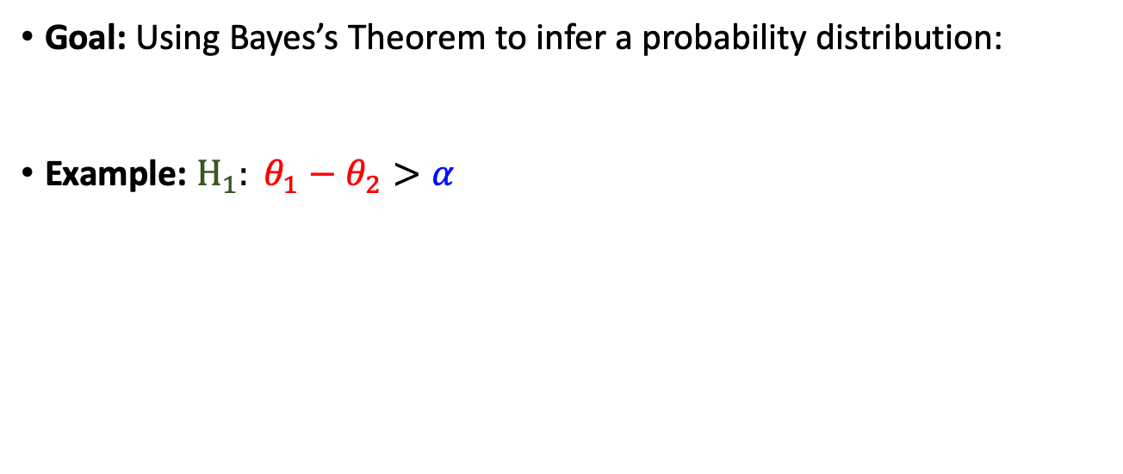
Posterior Intervals
Goal: Using Bayes’s Theorem to infer a probability distribution:
Example: $H_{1}: θ_{1}−θ_{2}>α$
$$P\left(Hypothesis | Observations\right)$$

Slide 138
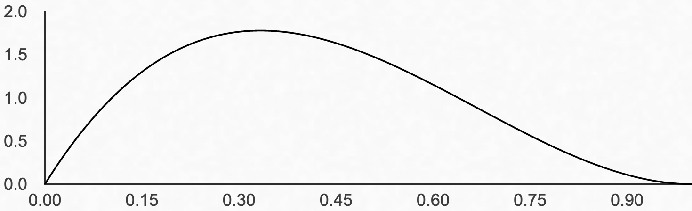
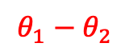
Posterior Intervals
Goal: Using Bayes’s Theorem to infer a probability distribution:
Example: $H_{1}: θ_{1}−θ_{2}>α$
$$P\left(Hypothesis | Observations\right)$$
$$θ_{1}−θ_{2}$$

Slide 139
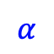
Posterior Intervals
Goal: Using Bayes’s Theorem to infer a probability distribution:
Example: $H_{1}: θ_{1}−θ_{2}>α$
$$P\left(Hypothesis | Observations\right)$$
$$θ_{1}−θ_{2}$$
$$α$$

Slide 140

Posterior Intervals
Goal: Using Bayes’s Theorem to infer a probability distribution:
Example: $H_{1}: θ_{1}−θ_{2}>α$
$$P\left(Hypothesis | Observations\right)$$
$$θ_{1}−θ_{2}$$
$$α$$

Slide 141
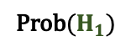
Posterior Intervals
Goal: Using Bayes’s Theorem to infer a probability distribution:
Example: $H_{1}: θ_{1}−θ_{2}>α$
$$P\left(Hypothesis | Observations\right)$$
Prob($H_{1})$
$$θ_{1}−θ_{2}$$
$$α$$

Slide 142
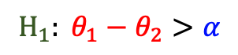
Posterior Intervals: Example
System | Accuracy
Ⓐ | 72.4
Ⓑ | 68.9
$$H_{1}: θ_{1}−θ_{2}>α$$

Slide 143
Posterior Intervals: Example
System | Accuracy
Ⓐ | 72.4
Ⓑ | 68.9
$$H_{1}: θ_{1}−θ_{2}>α$$
Ⓐ
Ⓑ

Slide 144
Posterior Intervals: Example
System | Accuracy
Ⓐ | 72.4
Ⓑ | 68.9
$$H_{1}: θ_{1}−θ_{2}>α$$
Ⓐ
Ⓑ

Slide 145
Posterior Intervals: Example
System | Accuracy
Ⓐ | 72.4
Ⓑ | 68.9
$$H_{1}: θ_{1}−θ_{2}>α$$
Ⓐ
Ⓑ

Slide 146
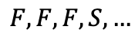
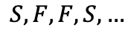
Posterior Intervals: Example
System | Accuracy
Ⓐ | 72.4
Ⓑ | 68.9
$$H_{1}: θ_{1}−θ_{2}>α$$
Ⓐ
$$S, F,F,S,…$$
Ⓑ
$$F, F,F,S,…$$

Slide 147
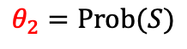
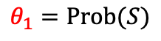
Posterior Intervals: Example
System | Accuracy
Ⓐ | 72.4
Ⓑ | 68.9
$$H_{1}: θ_{1}−θ_{2}>α$$
$$θ_{1}=Prob(S)$$
Ⓐ
$$S, F,F,S,…$$
$$θ_{2}=Prob(S)$$
Ⓑ
$$F, F,F,S,…$$

Slide 148
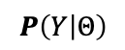
Posterior Intervals: Example
System | Accuracy
Ⓐ | 72.4
Ⓑ | 68.9
$$H_{1}: θ_{1}−θ_{2}>α$$
$$θ_{1}=Prob(S)$$
Ⓐ
$$S, F,F,S,…$$
$$θ_{2}=Prob(S)$$
Ⓑ
$$F, F,F,S,…$$
$$P\left(Y | Θ\right)$$

Slide 149
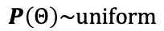
Posterior Intervals: Example
System | Accuracy
Ⓐ | 72.4
Ⓑ | 68.9
$$H_{1}: θ_{1}−θ_{2}>α$$
$$θ_{1}=Prob(S)$$
Ⓐ
$$S, F,F,S,…$$
$$θ_{2}=Prob(S)$$
Ⓑ
$$F, F,F,S,…$$
$$P\left(Y | Θ\right)$$
⊕
$$P\left(Θ\right)\sim uniform$$

Slide 150
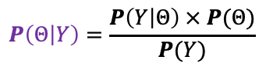
Posterior Intervals: Example
System | Accuracy
Ⓐ | 72.4
Ⓑ | 68.9
$$H_{1}: θ_{1}−θ_{2}>α$$
$$θ_{1}=Prob(S)$$
Ⓐ
$$S, F,F,S,…$$
$$θ_{2}=Prob(S)$$
Ⓑ
$$F, F,F,S,…$$
$$P\left(Y | Θ\right)$$
⊕
$$P\left(Θ | Y\right)=\frac{P\left(Y | Θ\right) × P(Θ)}{P(Y)}$$
$$P\left(Θ\right)\sim uniform$$

Slide 151
Posterior Intervals: Example
System | Accuracy
Ⓐ | 72.4
Ⓑ | 68.9
$$H_{1}: θ_{1}−θ_{2}>α$$
$$θ_{1}=Prob(S)$$
Ⓐ
$$S, F,F,S,…$$
$$θ_{2}=Prob(S)$$
Ⓑ
$$F, F,F,S,…$$
$$P\left(Y | Θ\right)$$
⊕
$$P\left(Θ | Y\right)=\frac{P\left(Y | Θ\right) × P(Θ)}{P(Y)}$$
$$P\left(Θ\right)\sim uniform$$

Slide 152
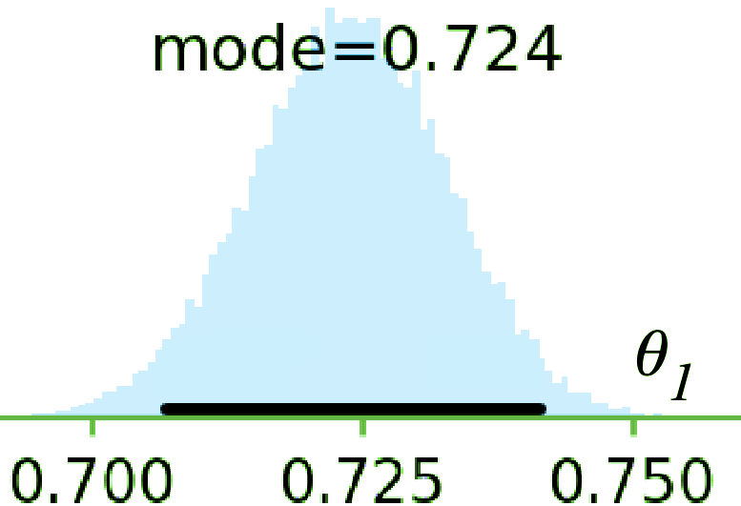
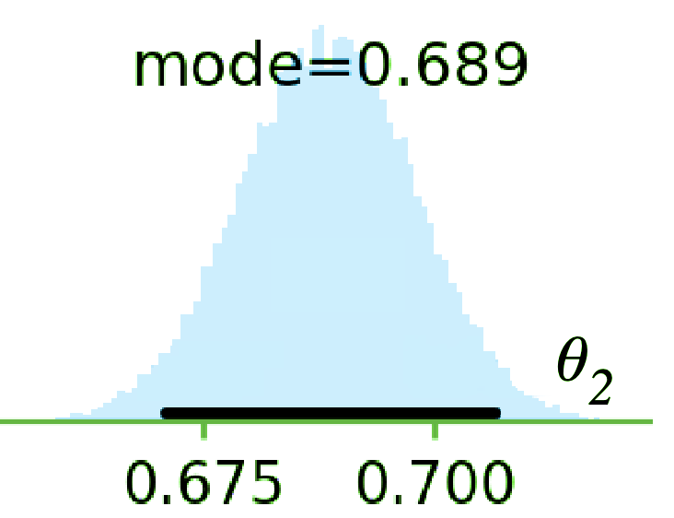
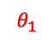
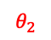
Posterior Intervals: Example
System | Accuracy
Ⓐ | 72.4
Ⓑ | 68.9
$$H_{1}: θ_{1}−θ_{2}>α$$
$$θ_{1}=Prob(S)$$
Ⓐ
$$θ_{1}$$
$$S, F,F,S,…$$
$$θ_{2}=Prob(S)$$
Ⓑ
$$F, F,F,S,…$$
$$θ_{2}$$
$$P\left(Y | Θ\right)$$
⊕
$$P\left(Θ | Y\right)=\frac{P\left(Y | Θ\right) × P(Θ)}{P(Y)}$$
$$P\left(Θ\right)\sim uniform$$

Slide 153
Posterior Intervals: Example
System | Accuracy
Ⓐ | 72.4
Ⓑ | 68.9
$$H_{1}: θ_{1}−θ_{2}>α$$
$$θ_{1}=Prob(S)$$
Ⓐ
$$θ_{1}$$
$$S, F,F,S,…$$
$$θ_{2}=Prob(S)$$
Ⓑ
$$F, F,F,S,…$$
$$θ_{2}$$
$$P\left(Y | Θ\right)$$
⊕
$$P\left(Θ | Y\right)=\frac{P\left(Y | Θ\right) × P(Θ)}{P(Y)}$$
$$P\left(Θ\right)\sim uniform$$

Slide 154
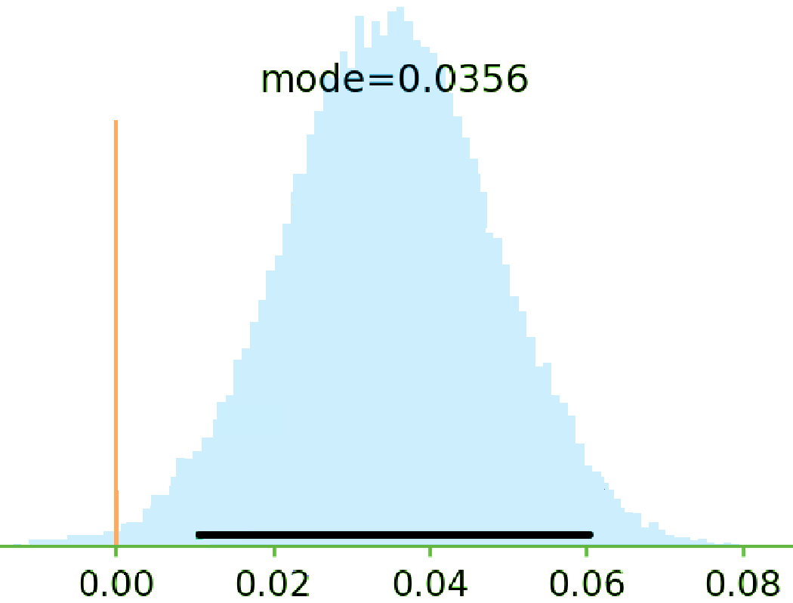
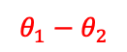
Posterior Intervals: Example
System | Accuracy
Ⓐ | 72.4
Ⓑ | 68.9
$$H_{1}: θ_{1}−θ_{2}>α$$
$$θ_{1}=Prob(S)$$
Ⓐ
$$θ_{1}$$
$$S, F,F,S,…$$
$$θ_{2}=Prob(S)$$
Ⓑ
$$F, F,F,S,…$$
$$θ_{2}$$
$$θ_{1}−θ_{2}$$
$$P\left(Y | Θ\right)$$
⊕
$$P\left(Θ | Y\right)=\frac{P\left(Y | Θ\right) × P(Θ)}{P(Y)}$$
$$P\left(Θ\right)\sim uniform$$

Slide 155
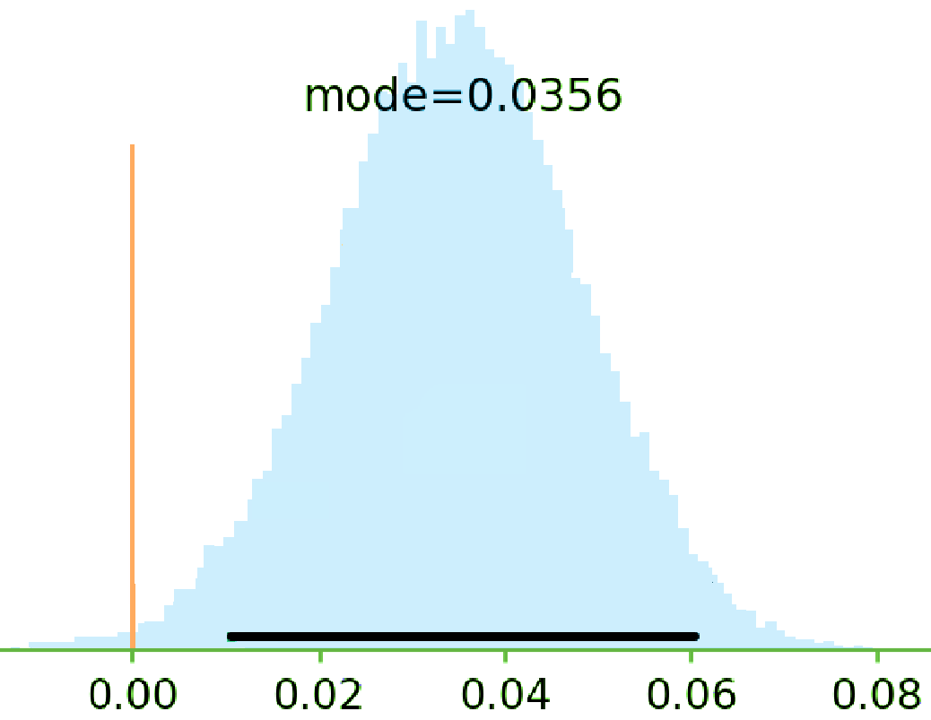
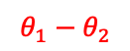
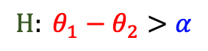
Posterior Intervals: Example
System | Accuracy
Ⓐ | 72.4
Ⓑ | 68.9
$$H: θ_{1}−θ_{2}>α$$
$$θ_{1}−θ_{2}$$

Slide 156
Posterior Intervals: Example
System | Accuracy
Ⓐ | 72.4
Ⓑ | 68.9
$$H: θ_{1}−θ_{2}>α$$
$$θ_{1}−θ_{2}$$

Slide 157
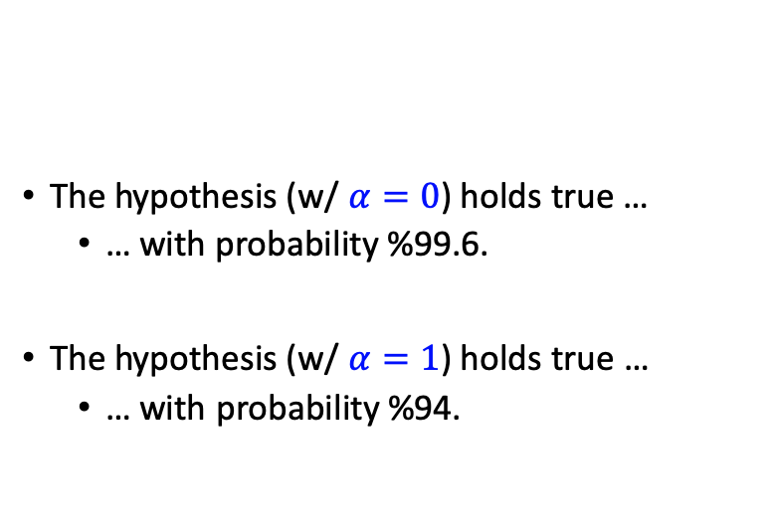
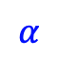
Posterior Intervals: Example
System | Accuracy
Ⓐ | 72.4
Ⓑ | 68.9
The hypothesis (w/ $α=0$) holds true …
… with probability %99.6.
The hypothesis (w/ $α=1$) holds true …
… with probability %94.
$$H: θ_{1}−θ_{2}>α$$
$$θ_{1}−θ_{2}$$
$$α$$

Slide 158
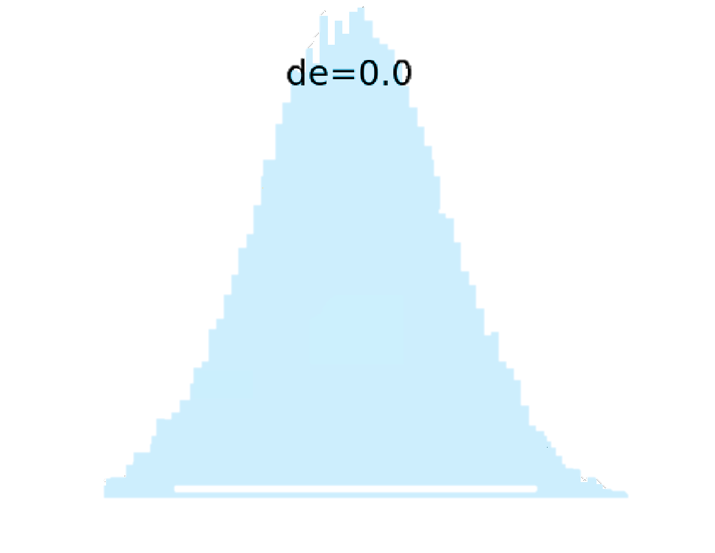
Posterior Intervals: Example
System | Accuracy
Ⓐ | 72.4
Ⓑ | 68.9
The hypothesis (w/ $α=0$) holds true …
… with probability %99.6.
The hypothesis (w/ $α=1$) holds true …
… with probability %94.
$$H: θ_{1}−θ_{2}>α$$
$$θ_{1}−θ_{2}$$
$$α$$

Slide 159
Posterior Intervals: Example
System | Accuracy
Ⓐ | 72.4
Ⓑ | 68.9
The hypothesis (w/ $α=0$) holds true …
… with probability %99.6.
The hypothesis (w/ $α=1$) holds true …
… with probability %94.
$$H: θ_{1}−θ_{2}>α$$
$$θ_{1}−θ_{2}$$
$$α$$

Slide 160
Posterior Intervals: Example
System | Accuracy
Ⓐ | 72.4
Ⓑ | 68.9
The hypothesis (w/ $α=0$) holds true …
… with probability %99.6.
The hypothesis (w/ $α=1$) holds true …
… with probability %94.
$$H: θ_{1}−θ_{2}>α$$
$$θ_{1}−θ_{2}$$

Slide 161
Posterior Intervals: Example
System | Accuracy
Ⓐ | 72.4
Ⓑ | 68.9
The hypothesis (w/ $α=0$) holds true …
… with probability %99.6.
The hypothesis (w/ $α=1$) holds true …
… with probability %94.
$$H: θ_{1}−θ_{2}>α$$
$$θ_{1}−θ_{2}$$

Slide 162
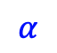
Posterior Intervals: Example
System | Accuracy
Ⓐ | 72.4
Ⓑ | 68.9
The hypothesis (w/ $α=0$) holds true …
… with probability %99.6.
The hypothesis (w/ $α=1$) holds true …
… with probability %94.
$$H: θ_{1}−θ_{2}>α$$
$$θ_{1}−θ_{2}$$
$$α$$

Slide 163
Posterior Intervals: Example
System | Accuracy
Ⓐ | 72.4
Ⓑ | 68.9
The hypothesis (w/ $α=0$) holds true …
… with probability %99.6.
The hypothesis (w/ $α=1$) holds true …
… with probability %94.
$$H: θ_{1}−θ_{2}>α$$
$$θ_{1}−θ_{2}$$
$$α$$

Slide 164
Posterior Intervals: Example
System | Accuracy
Ⓐ | 72.4
Ⓑ | 68.9
The hypothesis (w/ $α=0$) holds true …
… with probability %99.6.
The hypothesis (w/ $α=1$) holds true …
… with probability %94.
$$H: θ_{1}−θ_{2}>α$$
$$θ_{1}−θ_{2}$$
$$α$$

Slide 165
2nd Intermediate Summary
Frequentist
Bayesian
Binary Decision
Null-Hypothesis Significance Test
Bayes Factor
Uncertainty Estimations
Confidence Interval
Posterior Intervals

Slide 166
2nd Intermediate Summary
It’s much more intuitive to work with the probability of hypotheses.
Easier to interpret → less ambiguous.
Frequentist
Bayesian
Binary Decision
Null-Hypothesis Significance Test
Bayes Factor
Uncertainty Estimations
Confidence Interval
Posterior Intervals

Slide 167
2nd Intermediate Summary
It’s much more intuitive to work with the probability of hypotheses.
Easier to interpret → less ambiguous.
Provides a flexible framework
E.g., margin of superiority could incorporated in the definition of hypotheses.
This does not encourage binary decision-making.
Frequentist
Bayesian
Binary Decision
Null-Hypothesis Significance Test
Bayes Factor
Uncertainty Estimations
Confidence Interval
Posterior Intervals

Slide 168
2nd Intermediate Summary
It’s much more intuitive to work with the probability of hypotheses.
Easier to interpret → less ambiguous.
Provides a flexible framework
E.g., margin of superiority could incorporated in the definition of hypotheses.
This does not encourage binary decision-making.
Frequentist
Bayesian
Binary Decision
Null-Hypothesis Significance Test
Bayes Factor
Uncertainty Estimations
Confidence Interval
Posterior Intervals

Slide 169
Final Section: Common Practices, Comparisons and Suggestions
Frequentist
Bayesian
Binary/Categorical Decisions
Null-Hypothesis Significance Test
Bayes Factor
Uncertainty Estimations
Confidence Interval
Posterior Intervals

Slide 170
Survey of the NLP Community

Slide 171
Survey of the NLP Community
A questionnaire containing general and specific questions about significance assessment tools
Sent it to over 400 researchers randomly selected from ACL’18 proceedings
~50 individuals responded

Slide 172
Survey of the NLP Community
A questionnaire containing general and specific questions about significance assessment tools
Sent it to over 400 researchers randomly selected from ACL’18 proceedings
~50 individuals responded

Slide 173
Survey of the NLP Community
A questionnaire containing general and specific questions about significance assessment tools
Sent it to over 400 researchers randomly selected from ACL’18 proceedings
~50 individuals responded

Slide 174

Survey of the NLP Community
A questionnaire containing general and specific questions about significance assessment tools
Sent it to over 400 researchers randomly selected from ACL’18 proceedings
~50 individuals responded

Slide 175
Survey of the NLP Community
“I have learned about statistical hypothesis testing/assessment (via taking classes or reading it from other places).”

Slide 176
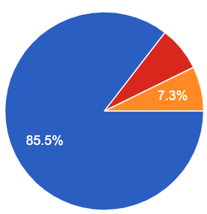
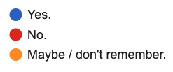
Survey of the NLP Community
“I have learned about statistical hypothesis testing/assessment (via taking classes or reading it from other places).”

Slide 177
Participants in Our Survey
“I have used "hypothesis testing" in the past (in a homework, a paper, etc.)”

Slide 178
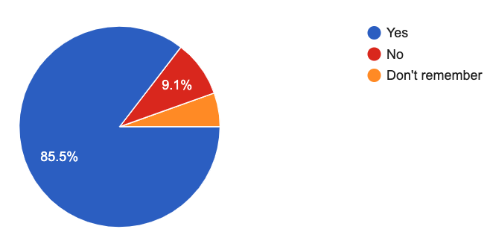
Participants in Our Survey
“I have used "hypothesis testing" in the past (in a homework, a paper, etc.)”

Slide 179
Participants in Our Survey
“I am not a robot”

Slide 180
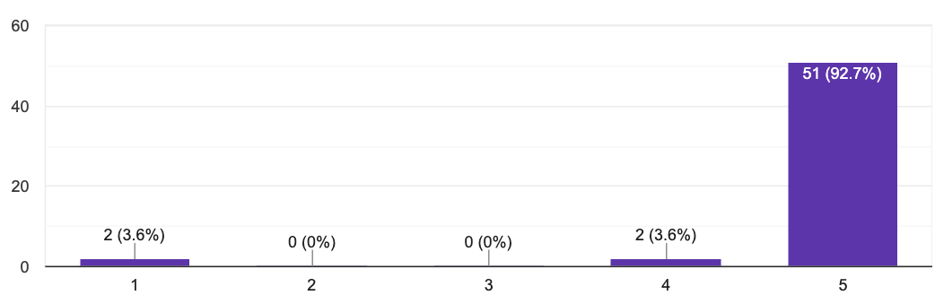
Participants in Our Survey
“I am not a robot”

Slide 181
Participants in Our Survey
“I am not a robot”

Slide 182
Participants in Our Survey
“I am not a robot”

Slide 183
Trends and Patterns in the field
Study NLP conference papers: ACL’18 papers (439 papers)
How many papers did use significance testing?
Frequentist
Bayesian
Binary Decision
Null-Hypothesis Significance Test
Bayes Factor
Uncertainty Estimations
Confidence Interval
Posterior Intervals

Slide 184
Trends and Patterns in the field
Study NLP conference papers: ACL’18 papers (439 papers)
How many papers did use significance testing?
Frequentist
Bayesian
73
Binary Decision
Null-Hypothesis Significance Test
Bayes Factor
Uncertainty Estimations
Confidence Interval
Posterior Intervals

Slide 185
Trends and Patterns in the field
Study NLP conference papers: ACL’18 papers (439 papers)
How many papers did use significance testing?
Frequentist
Bayesian
73
Binary Decision
Null-Hypothesis Significance Test
Bayes Factor
Uncertainty Estimations
Confidence Interval
Posterior Intervals
6

Slide 186
Trends and Patterns in the field
Study NLP conference papers: ACL’18 papers (439 papers)
How many papers did use significance testing?
Frequentist
Bayesian
73
0
Binary Decision
Null-Hypothesis Significance Test
Bayes Factor
Uncertainty Estimations
Confidence Interval
Posterior Intervals
6

Slide 187
Trends and Patterns in the field
Study NLP conference papers: ACL’18 papers (439 papers)
How many papers did use significance testing?
Frequentist
Bayesian
73
0
Binary Decision
Null-Hypothesis Significance Test
Bayes Factor
Uncertainty Estimations
Confidence Interval
Posterior Intervals
6
0

Slide 188
Trends and Patterns in the field
Study NLP conference papers: ACL’18 papers (439 papers)
How many papers did use significance testing?
Frequentist
Bayesian
73
0
Binary Decision
Null-Hypothesis Significance Test
Bayes Factor
Uncertainty Estimations
Confidence Interval
Posterior Intervals
Why?
6
0

Slide 190
Have you heard about "Bayesian Hypothesis Testing"?

Slide 191
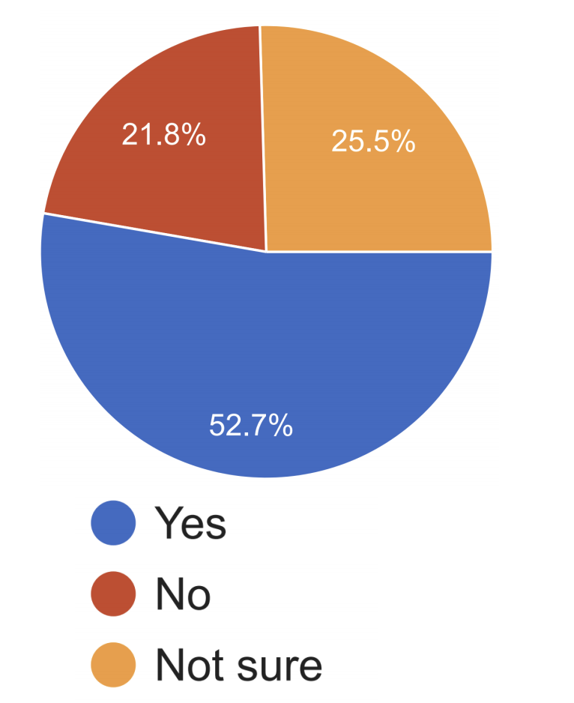
Have you heard about "Bayesian Hypothesis Testing"?

Slide 192
Have you heard about "Bayesian Hypothesis Testing"?
Do you know the definition of "Bayes Factor"?

Slide 193
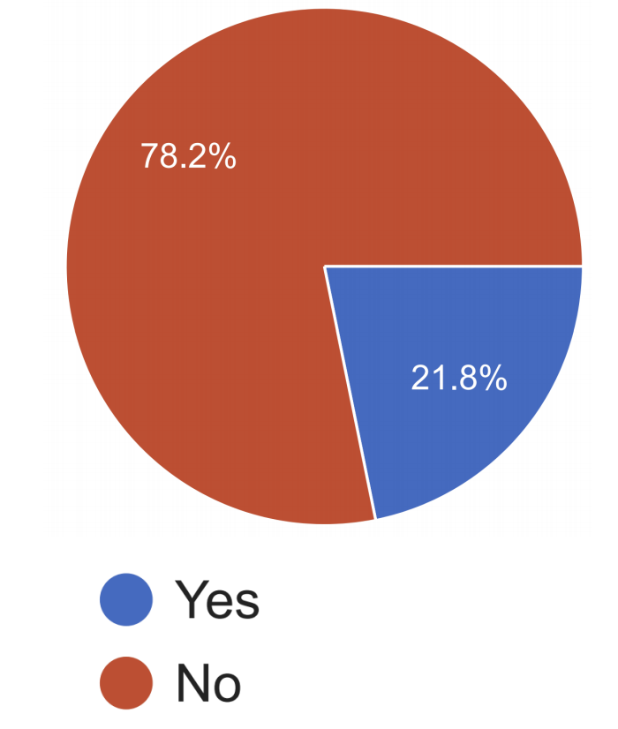
Have you heard about "Bayesian Hypothesis Testing"?
Do you know the definition of "Bayes Factor"?

Slide 194
Have you heard about "Bayesian Hypothesis Testing"?
Do you know the definition of "Bayes Factor"?
Many people did not know the definition of “Bayes Factor” and some only had “heard” about them. 🤔

Slide 195
Measures of [Un]Certainty
Frequentist
Bayesian
Binary Decision
Null-Hypothesis Significance Test
Bayes Factor
Uncertainty Estimations
Confidence Interval
Posterior Intervals
(Goodman, 2008; Wasserstein et al., 2016)

Slide 196
Measures of [Un]Certainty
P-values do not provide probability estimates on validity of hypotheses.
Frequentist
Bayesian
👎🏽
Binary Decision
Null-Hypothesis Significance Test
Bayes Factor
Uncertainty Estimations
Confidence Interval
Posterior Intervals
(Goodman, 2008; Wasserstein et al., 2016)

Slide 197
Measures of [Un]Certainty
P-values do not provide probability estimates on validity of hypotheses.
Frequentist
Bayesian
👎🏽
Binary Decision
Null-Hypothesis Significance Test
Bayes Factor
Uncertainty Estimations
Confidence Interval
Posterior Intervals
😑
(Goodman, 2008; Wasserstein et al., 2016)

Slide 198
Measures of [Un]Certainty
P-values do not provide probability estimates on validity of hypotheses.
Frequentist
Bayesian
👎🏽
👎🏽
Binary Decision
Null-Hypothesis Significance Test
Bayes Factor
Uncertainty Estimations
Confidence Interval
Posterior Intervals
😑
(Goodman, 2008; Wasserstein et al., 2016)

Slide 199
Measures of [Un]Certainty
P-values do not provide probability estimates on validity of hypotheses.
Posterior Intervals are interpretable in terms of post-data probabilities.
Frequentist
Bayesian
👎🏽
👎🏽
Binary Decision
Null-Hypothesis Significance Test
Bayes Factor
Uncertainty Estimations
Confidence Interval
Posterior Intervals
😑
👍🏽
(Goodman, 2008; Wasserstein et al., 2016)

Slide 200
Susceptibility to Misinterpretation
The complexity of interpreting significance tests could result in ambiguous or misleading conclusions.
P-values, while being the most common approach, are inherently complex and easy to misinterpret.
Frequentist
Bayesian
Binary Decision
Null-Hypothesis Significance Test
Bayes Factor
Uncertainty Estimations
Confidence Interval
Posterior Intervals

Slide 201
Susceptibility to Misinterpretation
The complexity of interpreting significance tests could result in ambiguous or misleading conclusions.
P-values, while being the most common approach, are inherently complex and easy to misinterpret.
Frequentist
Bayesian
👎🏽
Binary Decision
Null-Hypothesis Significance Test
Bayes Factor
Uncertainty Estimations
Confidence Interval
Posterior Intervals
😑

Slide 202
Participants in Our Survey
“I know p-values and I know how to interpret them.”

Slide 203
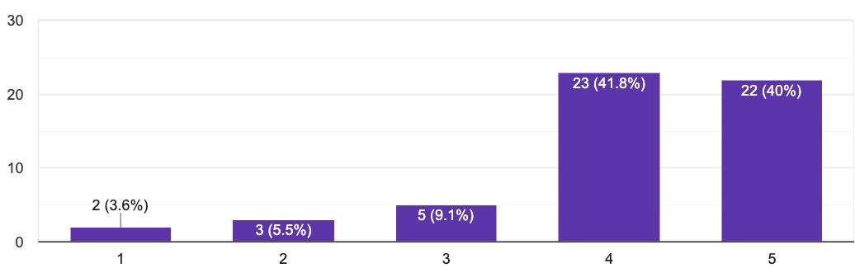
Participants in Our Survey
“I know p-values and I know how to interpret them.”

Slide 204
A Survey Question: Interpreting P-value

Slide 205
A Survey Question: Interpreting P-value
An NLP paper shows a performance of 38% for a classifier-1. They also show that adding a feature improves the performance to 45% (call this classifier-2). The authors claim that this finding is “statistically significant” with a significance level of 0.01. Which of the following(s) make sense?
The probability of observing a margin 7% is at most 0.01, assuming that the two classifiers inherently have the same performance.
If we repeat the experiment, with a probability 99% classifier-2 will have a higher performance than classifier-1.

Slide 206
A Survey Question: Interpreting P-value
An NLP paper shows a performance of 38% for a classifier-1. They also show that adding a feature improves the performance to 45% (call this classifier-2). The authors claim that this finding is “statistically significant” with a significance level of 0.01. Which of the following(s) make sense?
The probability of observing a margin 7% is at most 0.01, assuming that the two classifiers inherently have the same performance.
If we repeat the experiment, with a probability 99% classifier-2 will have a higher performance than classifier-1.

Slide 207
A Survey Question: Interpreting P-value
An NLP paper shows a performance of 38% for a classifier-1. They also show that adding a feature improves the performance to 45% (call this classifier-2). The authors claim that this finding is “statistically significant” with a significance level of 0.01. Which of the following(s) make sense?
The probability of observing a margin 7% is at most 0.01, assuming that the two classifiers inherently have the same performance.
If we repeat the experiment, with a probability 99% classifier-2 will have a higher performance than classifier-1.
🤦
23%
30%

Slide 208
Unintended Misleading Result by Iterative Testing

Slide 209
Unintended Misleading Result by Iterative Testing
Many tests are designed for a single-round experiment.
In practice researchers perform multiple rounds of experiments.
This is a major problem when using binary tests.
E.g., you can “hack” a p-value test, with enough repetitions.

Slide 210
Unintended Misleading Result by Iterative Testing
Expectation
Many tests are designed for a single-round experiment.
In practice researchers perform multiple rounds of experiments.
This is a major problem when using binary tests.
E.g., you can “hack” a p-value test, with enough repetitions.
Start
End

Slide 211
Unintended Misleading Result by Iterative Testing
Expectation
Many tests are designed for a single-round experiment.
In practice researchers perform multiple rounds of experiments.
This is a major problem when using binary tests.
E.g., you can “hack” a p-value test, with enough repetitions.
Start
End

Slide 212
Unintended Misleading Result by Iterative Testing
Reality
Expectation
Many tests are designed for a single-round experiment.
In practice researchers perform multiple rounds of experiments.
This is a major problem when using binary tests.
E.g., you can “hack” a p-value test, with enough repetitions.
Start
Start
???
End

Slide 213
Unintended Misleading Result by Iterative Testing
Reality
Expectation
Many tests are designed for a single-round experiment.
In practice researchers perform multiple rounds of experiments.
This is a major problem when using binary tests.
E.g., you can “hack” a p-value test, with enough repetitions.
Start
Start
???
End

Slide 214
The Need for Assumptions
Frequentist
Bayesian
Binary Decision
Null-Hypothesis Significance Test
Bayes Factor
Uncertainty Estimations
Confidence Interval
Posterior Intervals

Slide 215
The Need for Assumptions
Which tests have assumptions?
Assumptions are necessary to perform any statistical tests.
“no free lunch”
Many of them are questionable!
Frequentist
Bayesian
Binary Decision
Null-Hypothesis Significance Test
Bayes Factor
Uncertainty Estimations
Confidence Interval
Posterior Intervals

Slide 216
Ambiguity problem in interpreting “significance”

Slide 217

Ambiguity problem in interpreting “significance”

Slide 218

Ambiguity problem in interpreting “significance”

Slide 219

Ambiguity problem in interpreting “significance”

Slide 220
Ambiguity problem in interpreting “significance”

Slide 221
Ambiguity problem in interpreting “significance”
An NLP paper presents system-1 and it compares it with a baseline system-2. In its “abstract” it writes: “... system-1 significantly improves over system-2.” What are the right way(s) to interpret this (select all that applies)
It is expected that authors have performed some type of “hypothesis testing.”
It is expected that the authors have reported the performances of two systems on a dataset where system-1 has a higher performance than system-2 with a notable margin in the dataset.

Slide 222
Ambiguity problem in interpreting “significance”
An NLP paper presents system-1 and it compares it with a baseline system-2. In its “abstract” it writes: “... system-1 significantly improves over system-2.” What are the right way(s) to interpret this (select all that applies)
It is expected that authors have performed some type of “hypothesis testing.”
It is expected that the authors have reported the performances of two systems on a dataset where system-1 has a higher performance than system-2 with a notable margin in the dataset.

Slide 223
Ambiguity problem in interpreting “significance”
An NLP paper presents system-1 and it compares it with a baseline system-2. In its “abstract” it writes: “... system-1 significantly improves over system-2.” What are the right way(s) to interpret this (select all that applies)
It is expected that authors have performed some type of “hypothesis testing.”
It is expected that the authors have reported the performances of two systems on a dataset where system-1 has a higher performance than system-2 with a notable margin in the dataset.
83%

Slide 224
Ambiguity problem in interpreting “significance”
An NLP paper presents system-1 and it compares it with a baseline system-2. In its “abstract” it writes: “... system-1 significantly improves over system-2.” What are the right way(s) to interpret this (select all that applies)
It is expected that authors have performed some type of “hypothesis testing.”
It is expected that the authors have reported the performances of two systems on a dataset where system-1 has a higher performance than system-2 with a notable margin in the dataset.
83%
53%

Slide 225
The Usage of “Significance”: Our Recommendation
When referring to performing some type of “hypothesis testing,” use prefixes like “statistical”
When referring to big empirical improvements, use alternative terms like: “notable” or “remarkable.”

Slide 226
Tips and Suggestions
Frequentist
Bayesian
Binary Decision
Null-Hypothesis Significance Test
Bayes Factor
Define the research hypothesis you are after:
Uncertainty Estimations
Confidence Interval
Posterior Intervals
C1: Ⓐ and Ⓑ are inherently different, in the sense that if they were inherently identical, it would be highly unlikely to witness the observed 3.5% empirical gap.
C2: Ⓐ and Ⓑ are inherently different, since with probability at least 95%, the inherent accuracy of Ⓐ exceeds that of Ⓑ by at least 𝛼%.
…

Slide 227
Tips and Suggestions
Frequentist
Bayesian
Binary Decision
Null-Hypothesis Significance Test
Bayes Factor
If using frequentist tests:
The statements reporting p-value and confidence interval need to be precise.
… so that the results are not misinterpreted.
The term “significant” should be used with caution and clear purpose in order to not cause any misinterpretations.
better under a significance test != significantly better
One way to achieve this is by using adjectives “statistical” or “practical” before any (possibly inflected) usage of “significance.”
Uncertainty Estimations
Confidence Interval
Posterior Intervals

Slide 228

Tips and Suggestions
Frequentist
Bayesian
Binary Decision
Null-Hypothesis Significance Test
Bayes Factor
Uncertainty Estimations
Confidence Interval
Posterior Intervals
Lots of good tips about:
Selecting the right “test”
How to report your results.

Slide 229
Tips and Suggestions
If using Bayesian tests:
Be clear about your hierarchical model, any parameters in the model and the choice of priors.
Comment on the certainty (or the lack of) of your inference.
Frequentist
Bayesian
Binary Decision
Null-Hypothesis Significance Test
Bayes Factor
Uncertainty Estimations
Confidence Interval
Posterior Intervals

Slide 230

HyBayes Package

Slide 231


Slide 232
That’s it!

Slide 233




Participants in our Survey

Slide 234

Participants in our Survey

Slide 235
Participants in Our Survey
“I can understand almost all the "statistical" terms I encounter in papers.”

Slide 236

Participants in Our Survey
“I can understand almost all the "statistical" terms I encounter in papers.”

